Slide 1



`
Android Jetpack
Day 1
Created By: DoanPT1

Slide 2

Content
Android Jetpack
Android-KTX
ViewModel
LiveData
Lifecycles
Data Binding
Room database
WorkManager
Navigation
Paging
Hilt

Slide 3
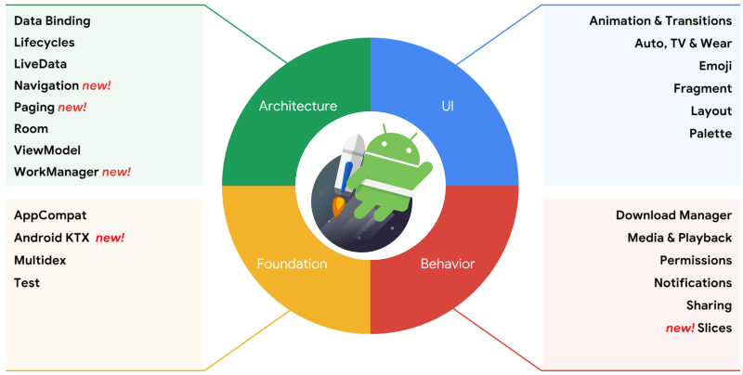
Jetpack
Jetpack is a suite of libraries to help developers follow best practices, reduce boilerplate code, and write code that works consistently across Android versions and devices so that developers can focus on the code they care about

Slide 4
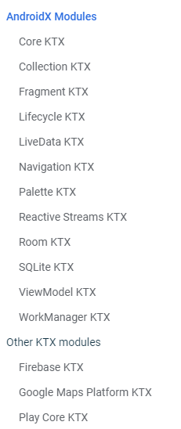
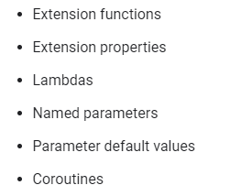
1. Android KTX
Android KTX is a set of Kotlin extensions that are included with Android Jetpack and other Android libraries. KTX extensions provide concise, idiomatic Kotlin to Jetpack, Android platform, and other APIs. To do so, these extensions leverage several Kotlin language features, including the following
Read more about KTX at here
Notes:
https://developer.android.com/kotlin/ktx

Slide 5






ViewModel
Confidential ⁵

Slide 6
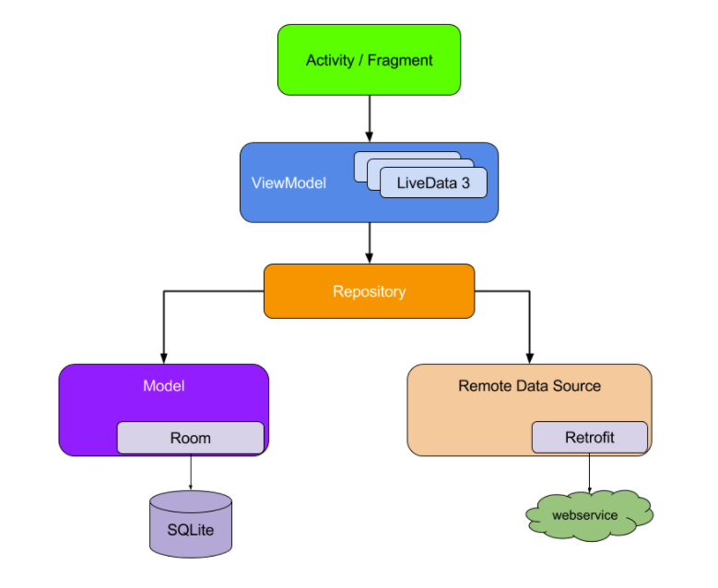
2. What is ViewModel
The ViewModel class is designed to store and manage UI-related data in a lifecycle conscious way. The ViewModel class allows data to survive configuration changes such as screen rotations
View
In this tutorial, we use Viewmodel along with MVVM app architecture. It’s recommand architecture design for android app
ViewModel
Model

Slide 7
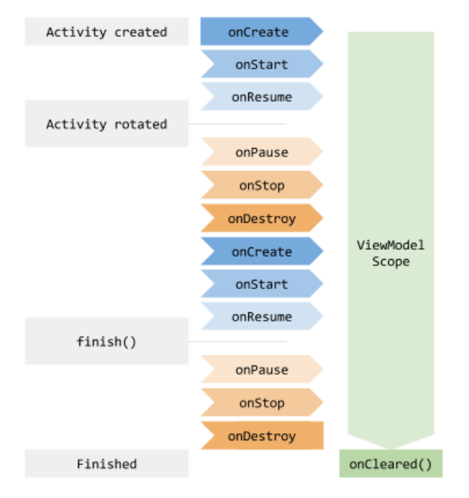
ViewModel lifecycles
ViewModel objects are scoped to the Lifecycle passed to the ViewModelProvider when getting the ViewModel. The ViewModel remains in memory until the Lifecycle it's scoped to goes away permanently: in the case of an activity, when it finishes, while in the case of a fragment, when it's detached.
You usually request a ViewModel the first time the system calls an activity object's onCreate() method. The system may call onCreate() several times throughout the life of an activity, such as when a device screen is rotated. The ViewModel exists from when you first request a ViewModel until the activity is finished and destroyed.

Slide 8
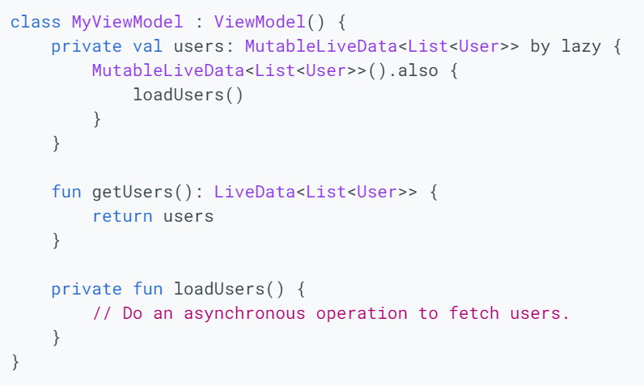
Implement a ViewModel
Architecture Components provides ViewModel helper class for the UI controller that is responsible for preparing data for the UI. ViewModel objects are automatically retained during configuration changes so that data they hold is immediately available to the next activity or fragment instance.
For example, if you need to display a list of users in your app, make sure to assign responsibility to acquire and keep the list of users to a ViewModel, instead of an activity or fragment, as illustrated by the following sample code:

Slide 9
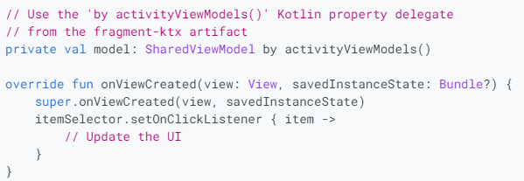
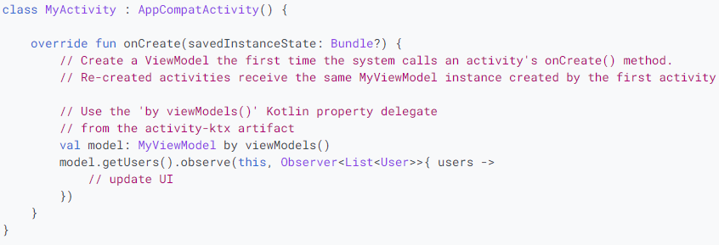
Use ViewModel
1. Use “by activityViewModels()” or by viewModels() method of fragment-ktx
Note: to use this ways, you need to add fragment-ktx to build.gradle
implementation "androidx.fragment:fragment-ktx:1.3.6"
Notes:
https://developer.android.com/topic/libraries/architecture/viewmodel#implement

Slide 10
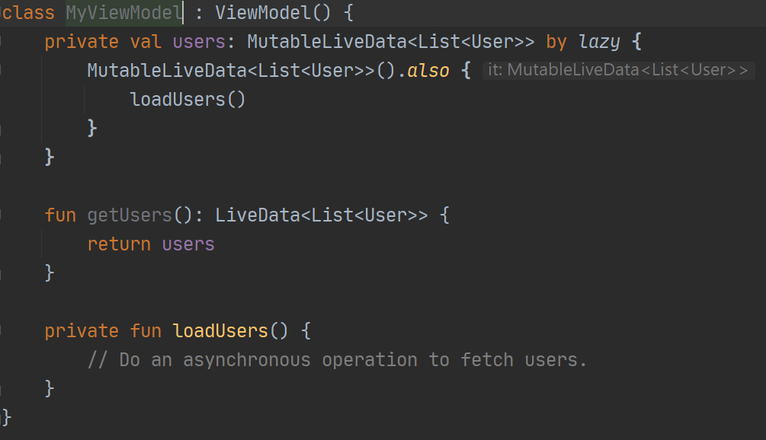
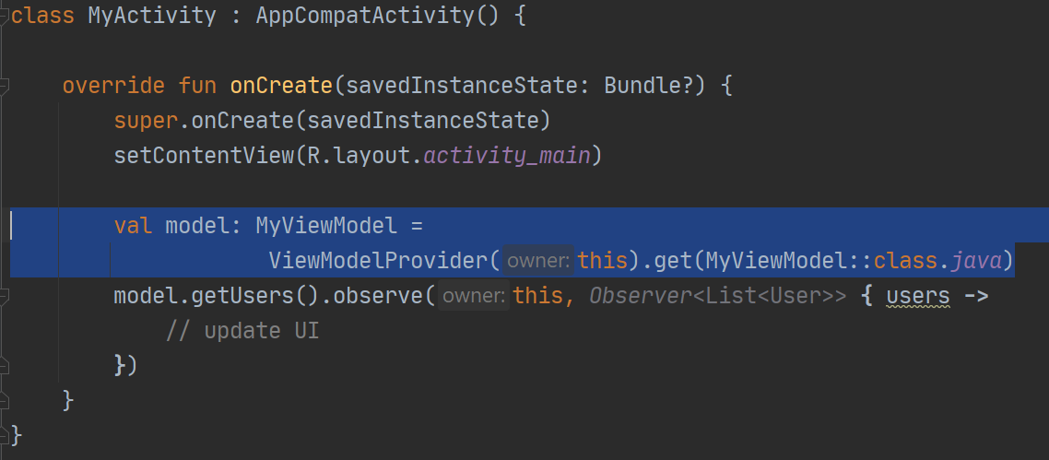
Use ViewModel
2. Use ViewModelProvider to get instance of ViewModel.

Slide 11
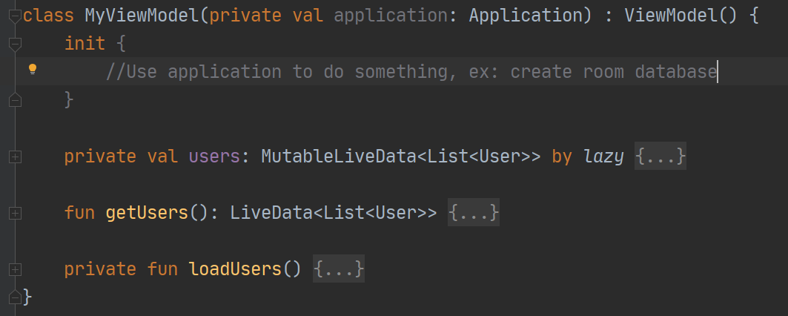
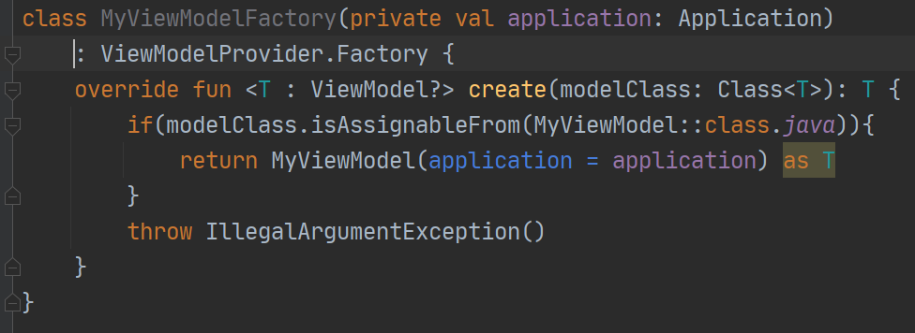
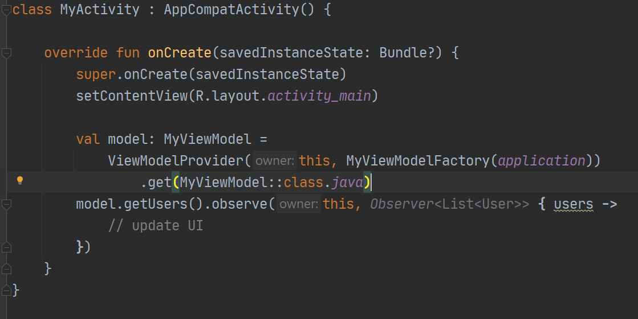
Use ViewModel
2. Use ViewModelProvider to get instance of ViewModel. But if your ViewModel has parameters in constructor, then you need to define a ViewModelProvider.Factory then pass an instance of it as second parameters of ViewModelProvider

Slide 12
Sharing Data between Fragments and Activities
It's very common that two or more fragments in an activity need to communicate with each other or some time you also want to share data between activity to fragments
Imagine a common case of split-view (master-detail) fragments, where you have a fragment in which the user selects an item from a list and another fragment that displays the contents of the selected item. This case is never trivial as both fragments need to define some interface description, and the owner activity must bind the two together. In addition, both fragments must handle the scenario where the other fragment is not yet created or visible.
This common pain point can be addressed by using ViewModel objects. These fragments can share a ViewModel using their activity scope to handle this communication, as illustrated by the following sample code
Sharing data | No Sharing Data
by activityViewModels () | by viewModels()
ViewModelProvider(requireActivity()).get() | ViewModelProvider(this).get()
Notes:
https://developer.android.com/topic/libraries/architecture/viewmodel#sharing

Slide 13
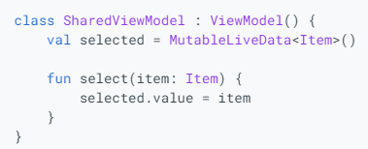
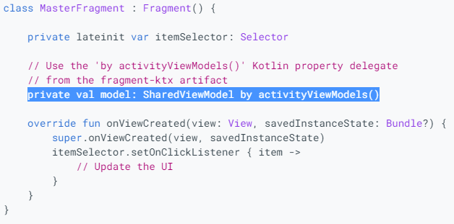
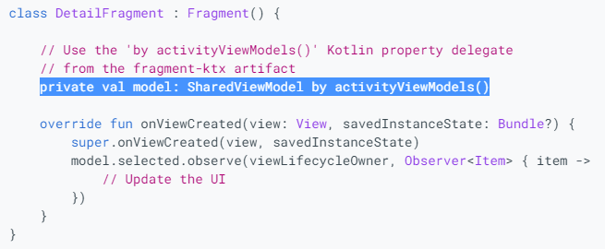
Sharing Data Example
In this example, when selected item changed, new data will be observed in both of MasterFragment and DetailFramgent
If you using “by viewModels()” or “ViewModelProvider(this).get()” then data will not be share.

Slide 14
DataBinding
Confidential ⁵

Slide 15
3. DataBinding
In Android development, we are using the findViewBindId function to obtain references to views in runtime, that is a very inefficient and resource consuming process.
Data binding will generates a corresponding binding class for each layout at complie time.
Advantages of Data binding:
Eliminate findViewById()
Update the values automatically.(doesn’t have to keep track of all the ways a value can be updated)
Very effective for UI Testing.
More readable code.
More maintainable code.
Faster development times.
Faster execution times.
Errors can be found during the compile time.
Well suited for MVVM and MVI architectures

Slide 16
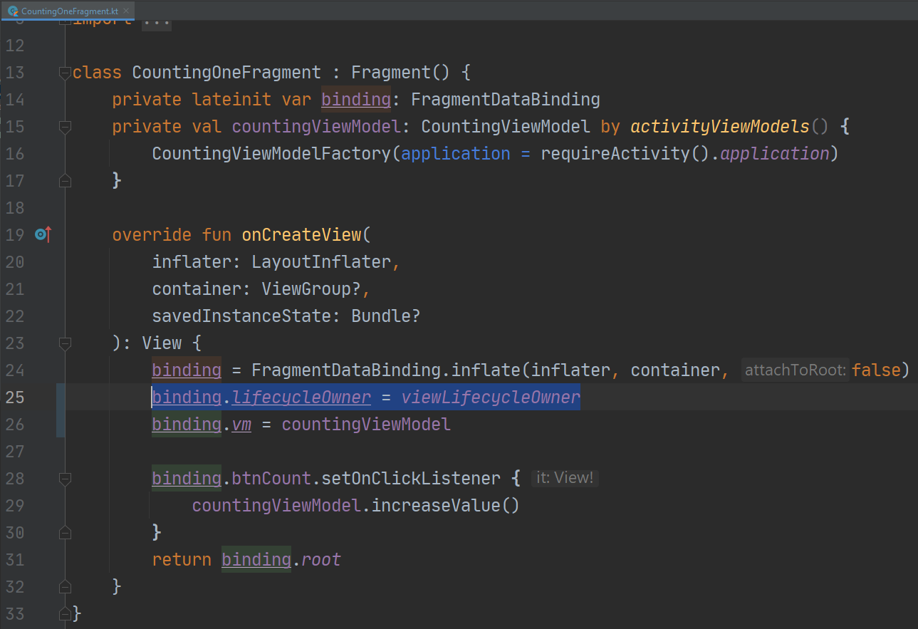
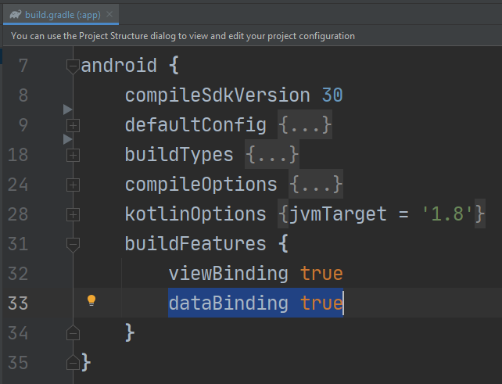
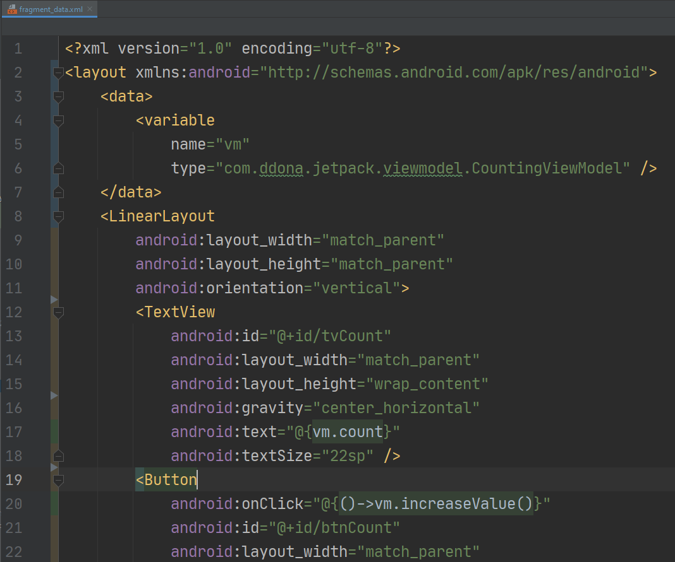
Data Binding – How to use
To use data binding in an Android app, we need to do 3 things:
Enable databinding in build.gradle file(app level)
Add layout tags as outermost tags of the xml file
Construct data binding object
Note: For listening LiveData in Fragment, we need set lifecycle owner for binding object, see picture 3

Slide 17
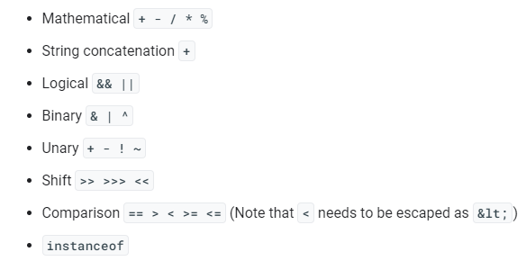
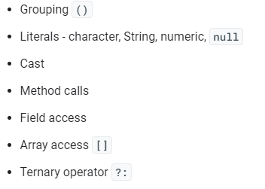
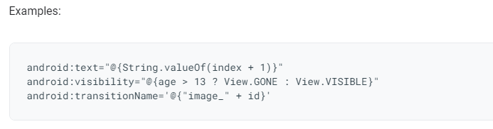
Data Binding – expression operators
The expression language looks a lot like expressions found in managed code. You can use the following operators and keywords in the expression language:
For more detail, refer here

Slide 18
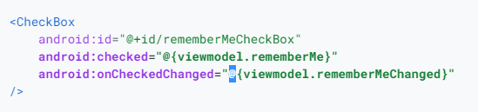
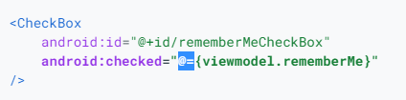
Data bingding – Two way binding
Using one-way data binding, you can set a value on an attribute and set a listener that reacts to a change in that attribute. In below example, the checked will be updated in layout code if you change value in viewmodel
Using two-way data binding, data can be update and listen in both of XML and java/kotlin code. This easy to do by using “@=“

Slide 19
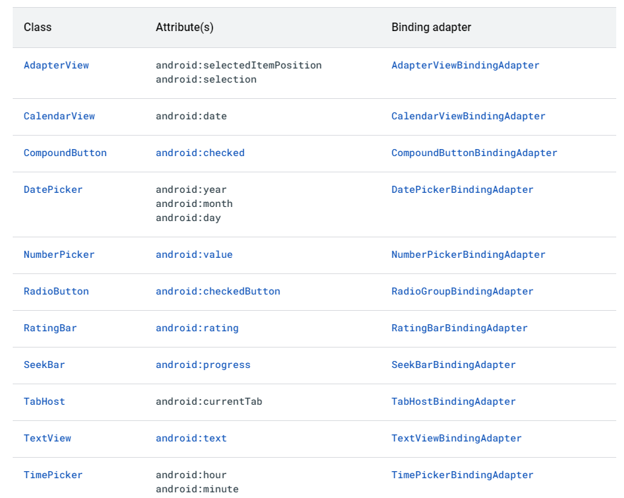
Data bingding – Two way binding support
The platform provides built-in support for two-way data binding when you use the attributes in the following table. For detail, please refer: here

Slide 20
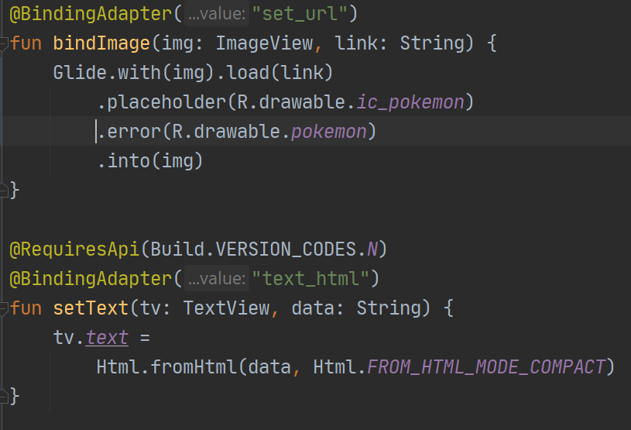
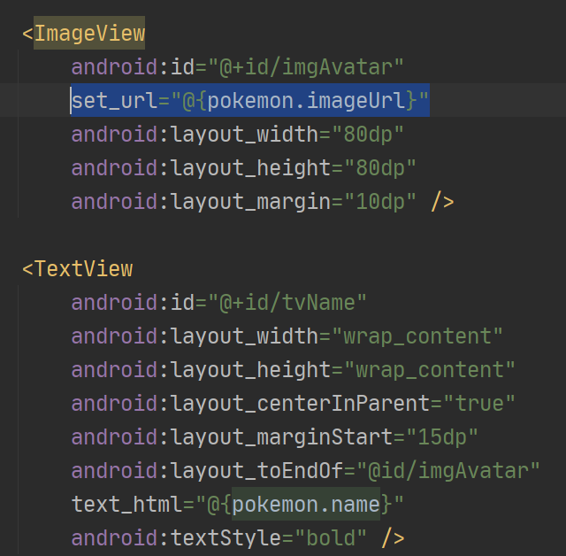
Data Binding – Binding Adapter
Binding adapters are responsible for making the appropriate framework calls to set values. It allows you to specify the method called to set a value, provide your own binding logic and specify the type of the returned object by using adapter.
Using
Notes:
Binding adapter chịu trách nhiiệm thực hiện framework call để set các giá trị. Nó cho phép bạn chỉ định phương thức được gọi để đặt giá trị, cung cấp logic ràng buộc của riêng bạn và chỉ định loại đối tượng trả về bằng cách sử dụng bộ điều hợp.
https://developer.android.com/topic/libraries/data-binding/binding-adapters

Slide 21
LiveData
Confidential ⁵

Slide 22
4. LiveData
LiveData is an observable data holder class. Unlike a regular observable, LiveData is lifecycle-aware, meaning it respects the lifecycle of other app components, such as activities, fragments, or services. This awareness ensures LiveData only updates app component observers that are in an active lifecycle state
LiveData advantages:
Ensures your UI matches your data state
No memory leaks
No crashes due to stopped activities
No more manual lifecycle handling
Always up to date data
Proper configuration changes
Sharing resources
Fore more detail, refer at here

Slide 23
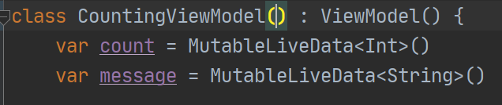
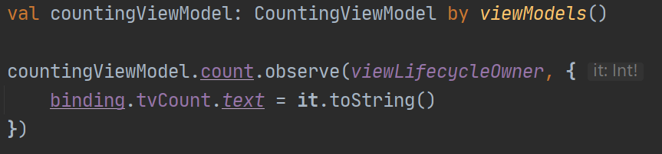
Work with LiveData
To work with LiveData, following below steps:
Create an instance of LiveData to hold a certain type of data. This is usually done within your ViewModel class.
Create an Observer object that defines the onChanged() method, which controls what happens when the LiveData object's held data changes. You usually create an Observer object in a UI controller, such as an activity or fragment.
Attach the Observer object to the LiveData object using the observe() method. The observe() method takes a LifecycleOwner object. This subscribes the Observer object to the LiveData object so that it is notified of changes. You usually attach the Observer object in a UI controller, such as an activity or fragment

Slide 24
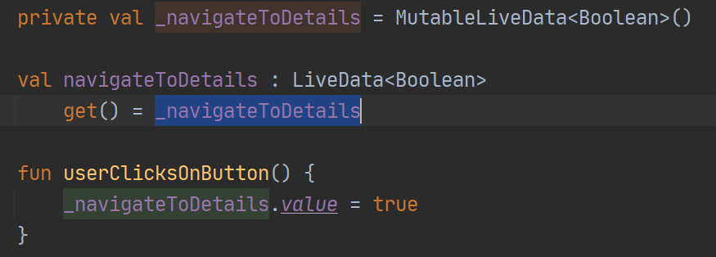
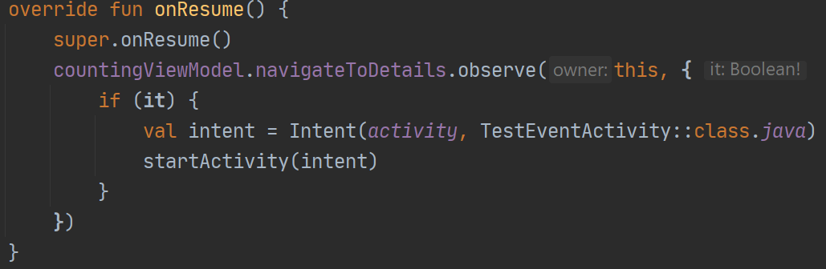
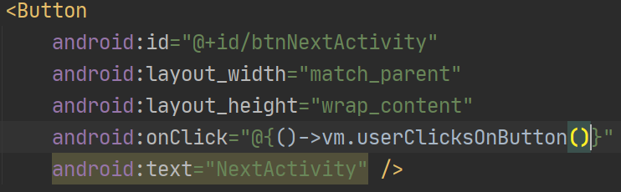
LiveData issue
Problems: When you need to handle context-dependent operations from viewmodel. Example: you need to show toast or start an activity when data in viewmodel change, you observe a attribute in viewmodel and start an activity, in some case when you back to activity. The viewmodel observe and get latest data, then it start activity again, you will NEVER can back to first activity

Slide 25
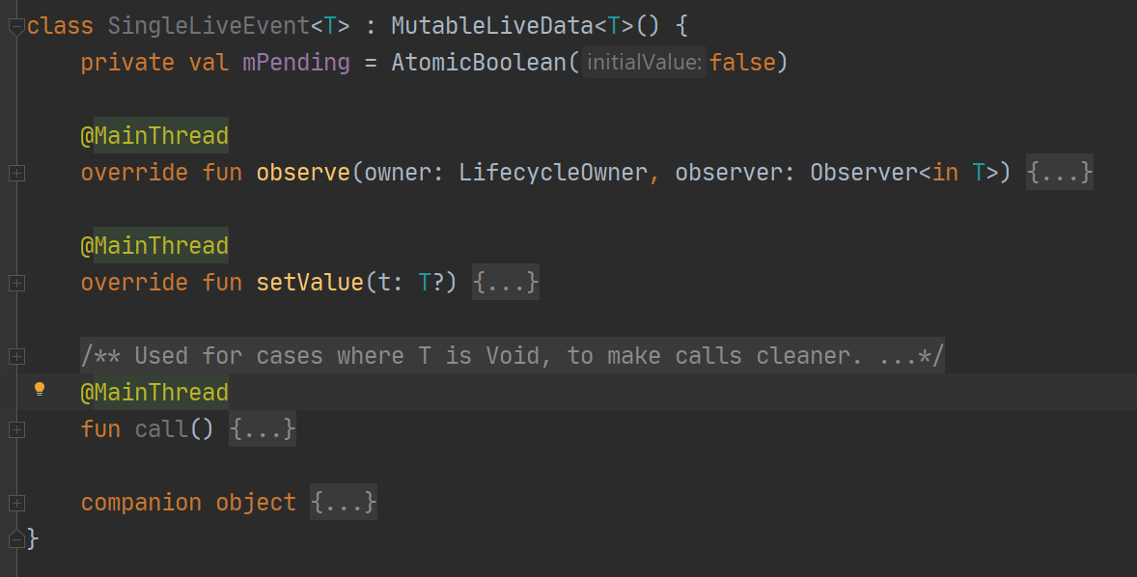
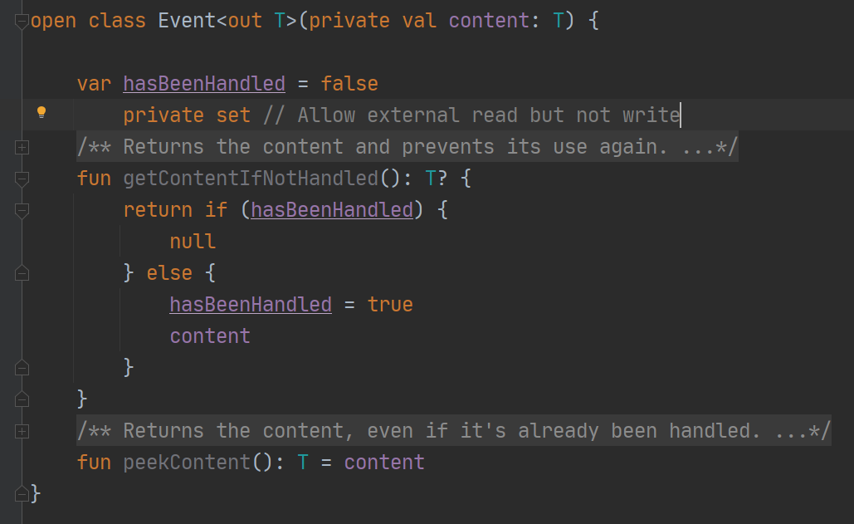
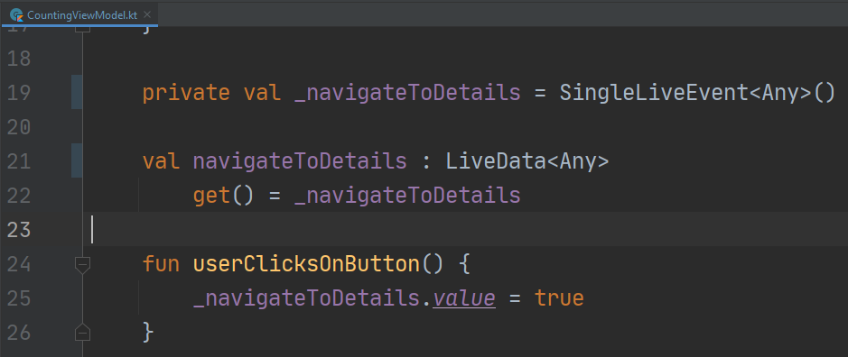
LiveData issue
Solution: You must using SingleLiveEvent or EventWrapper to handle one-time event
For more deteil: refer here
Problem source code: here
Solution source code: here

Slide 26
Lifecycle - Aware
Confidential ⁵

Slide 27
5. Lifecycles
Lifecycle-aware components perform actions in response to a change in the lifecycle status of another component, such as activities and fragments. These components help you produce better-organized, and often lighter-weight code, that is easier to maintain.
There are 3 main class that we will deal with:
LifeCycle
LifeCycleOwner
LifeCycleObserver

Slide 28
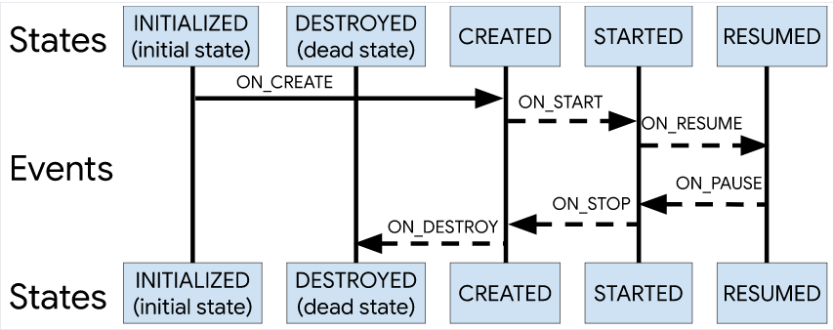
Lifecycle
A LifeCycle object is an object that can retrieve information about the current lifecycle of an LifeCycleOwner, typically the owner would be an Activity or a fragment.
The LifeCycle objects provides information about the lifecycle of the owner in the terms of Events and States.
Events are dispatched with respect to the life cycle owner events such as onCreate(), onStart(), onStop(),
Notes:
https://medium.com/@MinaSamy/android-architecture-components-lifecycle-433ace1ec05d
https://developer.android.com/topic/libraries/architecture/lifecycle

Slide 29
LifeCycleOwner and LifeCycleObserver
LifeCycleOwner:
Any class that implements the LifeCycleOwner interface indicates that it has Android LifeCycle.
For example, starting from Support Library 26.1.0 Fragments and Activities implement the LifeCycleOwner interface.
We can create custom LifeCycleOwner components by implementing the interface and using a LifeCycleRegistry as described here
LifeCicycleObserver: It’s a marker interface that indicates that the implementing interface is a LifeCycleObserver. We can use the OnLifecycleEvent annotations to define action corresponding to lifecycle event

Slide 30
WorkManager
Confidential ⁵

Slide 31
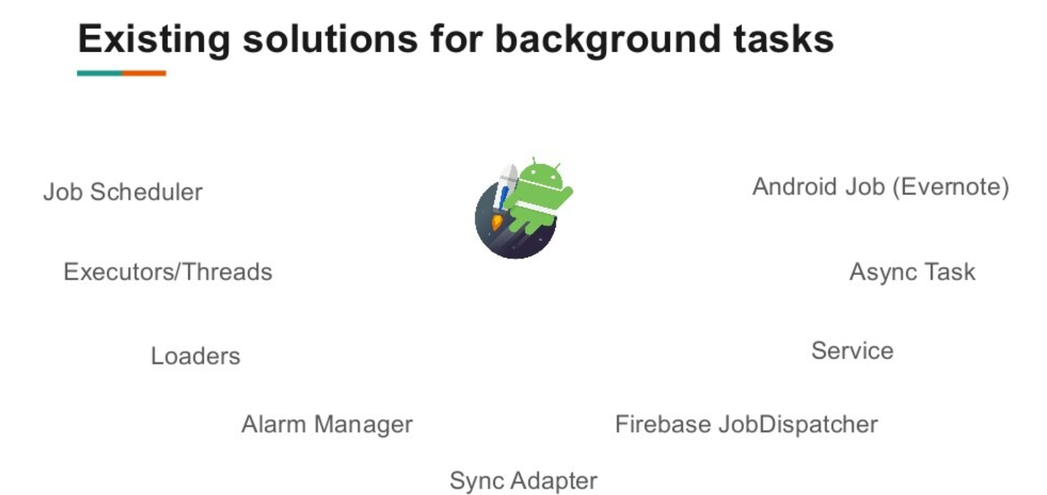
6. WorkManager
Look at below picture for Existing solutions for background tasks

Slide 32
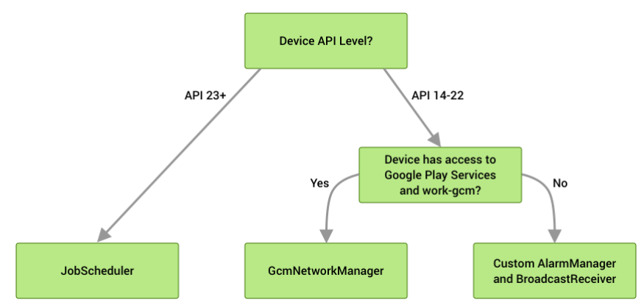
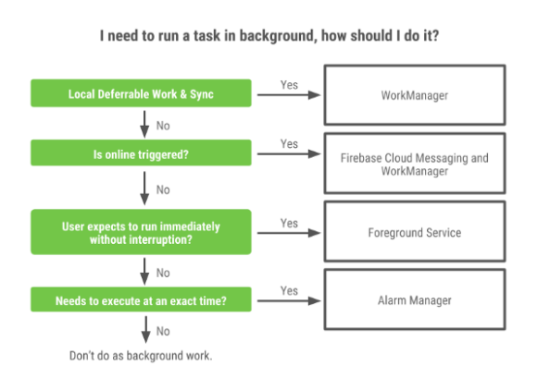
WorkManager
WorkManager is recommended solution for background execution, taking into account all IOS background execution limits
The work is guaranteed to run, even on app exits or the device restarts
The WorkManager API is a suitable and recommended replacement for all previous Android background scheduling APIs, including FirebaseJobDispatcher, GcmNetworkManager, and Job Scheduler
Works with and without Google Play Services
It should be used for all defferrable or guaranteed background work

Slide 33
WorkManager - Behind the Hood
Data
Processor
Work Request
JobScheduler
Constraints
Worker
JobDispatcher
Data
enqueue()
publish
Work Manager
Work Result
Executor
Save work
AlarmManager
Work Database
Update work state

Slide 34
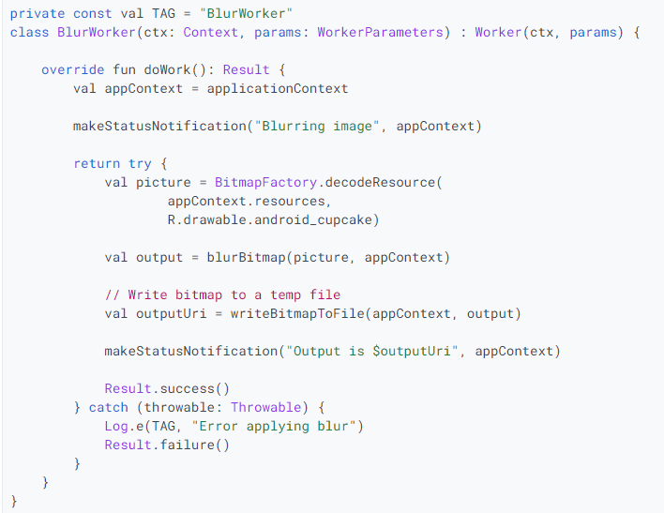
WorkManager - Worker
This is where you put the code for the actual work you want to perform in the background. You'll extend this class and override the doWork() method
Worker
doWork()
Result
Failure
Success
Retry

Slide 35
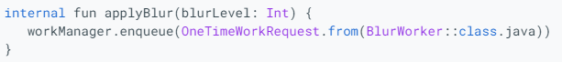
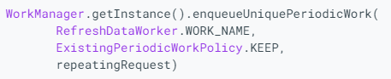
WorkManager – Work Request
WorkRequest is class to define how and when we should start work and it’s should be enqueued in WorkManager
There are 2 type of work request
OneTimeWorkRequest: A WorkRequest that will only execute once
PeriodicWorkRequest: A Work request that will repeat on a cycle
After you have a instance of work request, it should be enqueued in WorkManager

Slide 36
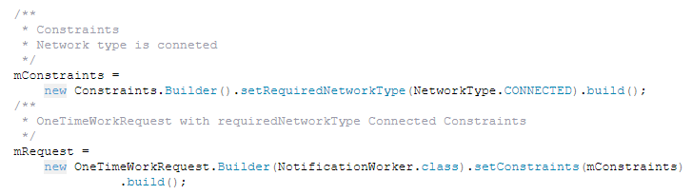
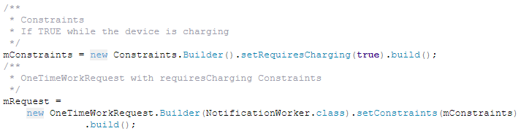
WorkManager – Work Constraints
WorkManager constraints specify the requirement that needs to be met before being executed task. In other words, you can say constraints specify the condition for running task under that specific condition. These constraints can be related to storage, battery or network
There are some type of Constraints provides by Workmanager:
requiresStorageNotLow()
requiresBatteryNotLow()
requiresCharging()
requiresDeviceIdle()
getRequiredNetworkType(): you can specify the NetworkType

Slide 37
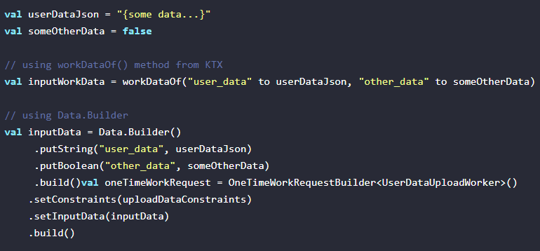
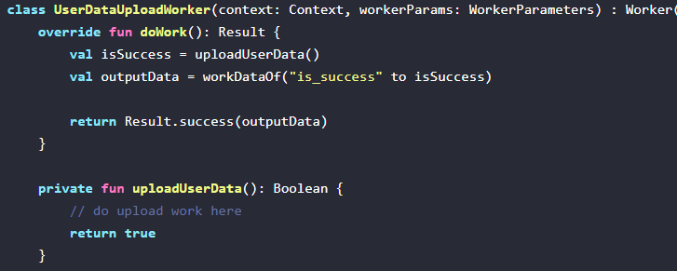
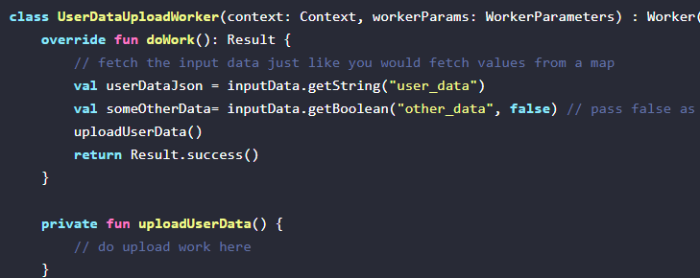
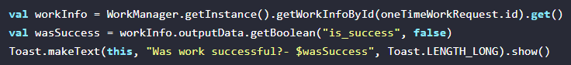
WorkManager - Input Data and Output Data
To do works, sometime you need to put input data for worker and you can get result of work in output.
After do the work, you can use Result class to return status of work. There are 3 type of Result: success, failture and retry

Slide 38
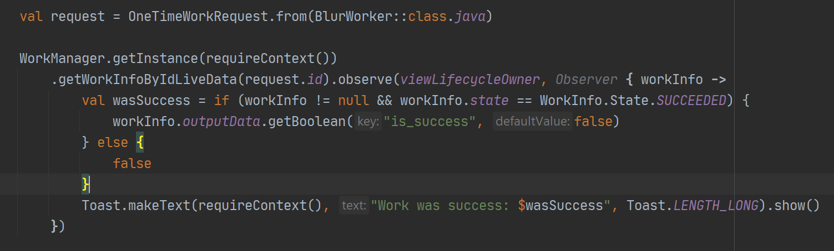
Observing worker with LiveData
WorkManager lets you observe the states of the worker by returning LiveData for the requested WorkInfo and observing this LiveData for any changes.
You can get work by Work Request Id, Tag or Unique name

Slide 39
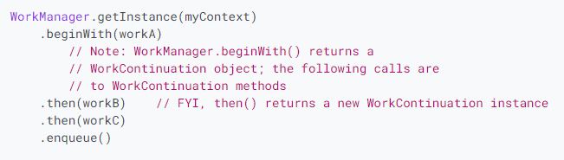


Chain work
WorkManager allows you to create separate WorkerRequests that run in order or parallel. In this step you'll create a chain of work that looks like this:

Slide 40


Work continuation
You can create more complex sequences by joining multiple chains with the WorkContinuation.combine(List<OneTimeWorkRequest>) methods. For example, suppose you want to run a sequence like this

Slide 41

WorkManager – Cancelling work
If you no longer need your previously enqueued work to run, you can ask for it to be cancelled. Work can be cancelled by its name, id or by a tag associated with it

Slide 42


Threading in WorkManager
When you use a Worker, WorkManager automatically calls Worker.doWork() on a background thread. The background thread comes from the Executor specified in WorkManager's Configuration. By default, WorkManager sets up an Executor for you - but you can also customize your own.

Slide 43

WorkManager with RxWorker
We provide interoperability between WorkManager and RxJava2. To get started, include work-rxjava2 the dependency in addition to work-runtime in your gradle file. Then, instead of extending Worker, you should extend RxWorker. Finally override the RxWorker.createWork() method to return a Single<Result> indicating the Result of your execution, as follows
Note : RxWorker.createWork() is called on the main thread, but the return value is subscribed to a background thread by default. You can override RxWorker.getBackgroundScheduler() to change the subscribing thread

Slide 44

WorkManager with CoroutineWorker
For Kotlin users, WorkManager provides first-class support for coroutines. To get started, include work-runtime-ktx in your gradle file. Instead of extending Worke, you should extend, which has a slightly different API. For example, if you wanted to build a simple CoroutineWorker to perform some network operations, you would do the following
Note : RxWorker.createWork() is called on the main thread, but the return value is subscribed to a background thread by default. You can override RxWorker.getBackgroundScheduler() to change the subscribing thread
Notes:
https://abhiappmobiledeveloper.medium.com/use-of-workmanager-in-android-app-part-4-81038067e1dd

Slide 45
Navigation
Confidential ⁵

Slide 46
7. Navigation Overview
Navigation refers to the interactions that allow users to navigate across, into, and back out from the different pieces of content within your app
The Navigation component consists of three key parts that are described below:
Navigation graph: An XML resource that contains all navigation-related information in one centralized location. This includes all of the individual content areas within your app, called destinations, as well as the possible paths that a user can take through your app.
NavHost: An empty container that displays destinations from your navigation graph. The Navigation component contains a default NavHost implementation, NavHostFragment, that displays fragment destinations.
NavController: An object that manages app navigation within a NavHost

Slide 47
Principles of Navigation
Starting point – visible when application is started from a launcher, it's the last screen
after returning by pressing back button
Navigation state is represented by a stack (start destination at the bottom, current destination at the top of the stack)
Up button takes user to hierarchical parent destination, never exits the app
Up button function identically to the system Back button in your own app's task
(when back button would not exit your app)
Deep link to a destination has got the same stack as it would be by navigating from start destination (user is able to use Back or Up buttons to navigate
through destinations back to the start destination). Any existing navigation stack is removed and replaced with the deep link's navigation stack

Slide 48

Setting up navigation in a project
Gradle(Project)
classpath "androidx.navigation:navigation-safe-args-gradle-plugin:2.3.5"
Gradle(App module)
plugins { id 'androidx.navigation.safeargs.kotlin' }
// Kotlin implementation("androidx.navigation:navigation-fragment-ktx:$nav_version") implementation("androidx.navigation:navigation-ui-ktx:$nav_version") // Feature module Support implementation("androidx.navigation:navigation-dynamic-features-fragment:$nav_version")
Create a new resource file of type Navigation in res folder:
navigation resource directory is created
nav_graph.xml is created which contains navigation graph

Slide 49
Navigation - Destinations
Destinations:
Activities
Fragments
Can be created in Editor as blank destination or from existing Fragments and Activities in our project
<navigation xmlns:android="http://schemas.android.com/apk/res/android" xmlns:app="http://schemas.android.com/apk/res-auto"
android:id="@+id/nav_graph_sale"
app:startDestination="@id/amountEntryFragment">
<!-- Screen Amount Entry input -->
<fragment android:id="@+id/amountEntryFragment" android:name="com.ingenico.uipresentation.fragment.AmountEntryFragment" android:label="AmountEntryFragment">
</fragment>
</navigation>

Slide 50
Navigation - Actions
Actions are scoped to the destination they are attached to the same action on a different destination can have different behavior.
It means the same action can have different destination it points
to and also different attributes like transition animations
<fragment
android:id="@+id/notesFragment" android:name="com.jshvarts.notesnavigation.presentation.notelist.NoteListFragment" android:label="@string/label_note_list" tools:layout="@layout/note_list_fragment">
<action
android:id="@+id/action_notes_to_addNote" app:destination="@id/addNoteFragment" />
<action
android:id="@+id/action_notes_to_noteDetail" app:destination="@id/noteDetailFragment" app:enterAnim="@anim/enter_slide_down" app:exitAnim="@anim/exit_slide_down" app:popEnterAnim="@anim/pop_enter_slide_up" app:popExitAnim="@anim/pop_exit_slide_up">
</action>
</fragment>

Slide 51
Navigation - Hosting navigation
An activity hosts navigation for an application through the implementation of NavHost interface - Navigation Architecture Component’s default is NavHostFragment. It is added to the activity’s layout.
<LinearLayout
android:layout_width="match_parent" android:layout_height="match_parent" android:orientation="vertical">
<androix.fragment.app.FragmentContainerView
android:id="@+id/nav_host_fragment" android:name="androidx.navigation.fragment.NavHostFragment" android:layout_width="match_parent" android:layout_height="match_parent" app:defaultNavHost="true" app:navGraph="@navigation/mobile_navigation" />
</LinearLayout>

Slide 52
Navigation - NavHostFragment
NavHostFragment swaps in and out different fragment destinations as user navigates through the
navigation graph.
Navigation graph is associated by navGraph attribute:
app:navGraph="@navigation/mobile_navigation"
To ensure that NavHostFragment intercepts the system Back button:
app:defaultNavHost="true"
To support Up button there is a need to overwrite
override fun onSupportNavigateUp(): Boolean {
return navigateUp(findNavController(this, R.id.nav_host_fragment), drawerLayout)
}

Slide 53
Navigation - Navigation Controller
Navigation to a destination is done by NavController class.
A NavController can be retrieved using one of the following static methods:
NavHostFragment.findNavController(Fragment)
Navigation.findNavController(Activity, @IdRes int viewId)
Navigation.findNavController(View)
View.findNavController()
navigate() method is used to navigate to a destination. It accepts ID of a destination or of an action.

Slide 54
Navigation - Navigation Controller
Useful methods:
NavController.navigateUp()
NavController.popBackStack()
They will be translated into appropriate framework operations.
For example when we navigate() to an activity destination, the NavController calls startActivity() on our behalf.
Pressing Up and Back button calls these methods respectively to pop the top destination off the stack.

Slide 55
Passing data between destinations
Every destination can define what arguments it can receive.
Two possible ways of passing data between destinations:
using Bundle
type-safe way using safeargs Gradle plugin
To enable safeargs, add below line to build.gradle
apply plugin: 'androidx.navigation.safeargs.kotlin'

Slide 56



Passing data – adding arguments
Create Bundle and pass it to the destination using navigate() method. Enable safeArgs for easy
passing Data between fragment
apply plugin: 'androidx.navigation.safeargs.kotlin'

Slide 57
Nested navigation graph
A series of destinations can be grouped into a sub-graph within a navigation graph.
Useful for organizing and reusing sections of app’s UI like a login flow.
Nested graph must have a start destination.
Root graph only accesses the nested graph through its starting destination
In navigation graph you can reference other graph by using <include>
<include app:graph="@navigation/nav_graph_sale" />

Slide 58


Deep linking to a destination
Deep links allow to jump in the middle of app’s navigation. It can be from an url link or pending intent.
Navigation library ensures users start on the appropriate destination with the appropriate back stack.
When user uses the Back button they navigate back up the navigation stack just as though they entered app from app’s entry point.
When deep link is triggered, the task back stack is cleared and replaced with the deep link destination.

Slide 59


Navigation – Transition fragments
The Navigation component lets you add both property and view animations to actions. To create your own animations, check out Animation resources.
Navigation also includes several default animations to get you started

Slide 60
Navigation – with menu
To let navigation with work menu, the important thing is use menu id same with destinition id in navigation graph.
For more detail refer:
Navigation with actionbar and toolbar: Link
Navigation with menu and Global action: Link
Navigation with bottom navigation view: Link
Navigation with drawer layout and navigation view: Link
More official document: https://developer.android.com/guide/fragments/appbar

Slide 61
Paging
Confidential ⁵
Notes:
https://developer.android.com/topic/libraries/architecture/paging/v3-overview

Slide 62
8. Paging
The Paging library helps you load and display pages of data from a larger dataset from local storage or over network. This approach allows your app to use both network bandwidth and system resources more efficiently. The components of the Paging library are designed to fit into the recommended Android app architecture, integrate cleanly with other Jetpack components, and provide first-class Kotlin support.
Benefits of using the Paging library
In-memory caching for your paged data. This ensures that your app uses system resources efficiently while working with paged data.
Built-in request deduplication, ensuring that your app uses network bandwidth and system resources efficiently
Configurable RecyclerView adapters that automatically request data as the user scrolls toward the end of the loaded data.
First-class support for Kotlin coroutines and Flow, as well as LiveData and RxJava.
Built-in support for error handling, including refresh and retry capabilities.

Slide 63

Library Architecture
The Paging library integrates directly into the recommended Android app architecture. The library's components operate in three layers of your app:
The repository layer
The ViewModel layer
The UI layer
Notes:
Repository layer
The primary Paging library component in the repository layer is PagingSource. Each PagingSource object defines a source of data and how to retrieve data from that source. A PagingSource object can load data from any single source, including network sources and local databases.
Another Paging library component that you might use is RemoteMediator. A RemoteMediator object handles paging from a layered data source, such as a network data source with a local database cache.
ViewModel layer
The Pager component provides a public API for constructing instances of PagingData that are exposed in reactive streams, based on a PagingSource object and a PagingConfig configuration object.
The component that connects the ViewModel layer to the UI is PagingData. A PagingData object is a container for a snapshot of paginated data. It queries a PagingSource object and stores the result.
UI layer
The primary Paging library component in the UI layer is PagingDataAdapter, a RecyclerView adapter that handles paginated data.
https://developer.android.com/topic/libraries/architecture/paging/v3-overview

Slide 64


PagingSource
PagingSource object defines a source of data and how to retrieve data from that source. A PagingSource object can load data from any single source, including network sources and local databases
An instance of a PagingSource is used to load pages of data for an instance of PagingData.

Slide 65


Remote Mediator
A RemoteMediator object handles paging from a layered data source, such as a network data source with a local database cache
Notes:
https://developer.android.com/reference/kotlin/androidx/paging/RemoteMediator
https://developer.android.com/topic/libraries/architecture/paging/v3-network-db

Slide 66



Pager
The Pager component provides a public API for constructing instances of PagingData that are exposed in reactive streams, based on a PagingSource object and a PagingConfig configuration object.
Pager for network data source
Pager for local data source(DB)
Pager for remote mediator(load from network and saved to database)
Notes:
https://developer.android.com/reference/kotlin/androidx/paging/Pager

Slide 67


PagingDataAdapter
The primary Paging library component in the UI layer is PagingDataAdapter, a RecyclerView adapter that handles paginated data
Notes:
https://developer.android.com/reference/kotlin/androidx/paging/PagingDataAdapter

Slide 68
Room database
Confidential ⁵

Slide 69
#1. How to save data in android app?
Internal Storage (File, Database, Shared Prefereneces)
External Storage (File)

Slide 70
#2. What is room database?
Room database is developed and improved from SQLite. Room database simplifies coding and minimizes database related operations.
Components: Database, DAO (Data Access Object) and Entity.

Slide 71
#3. Why should use Room Database to change SQLite
In case of SQLite, There is no compile time verification of raw SQLite queries. But in Room there is SQL validation at compile time.
As your schema changes, you need to update the affected SQL queries manually. Room solves this problem.
You need to use lots of boilerplate code to convert between SQL queries and Data objects. But, Room maps our database objects to Data Object without boilerplate code.
Room is built to work with LiveData for data observation, while SQLite does not.

Slide 72

Room – Gradle config
Grade:

Slide 73

#5. Room Architecture
There are 3 major components in Room:
Database
Entity
DAO (Data Access Object)

Slide 74

Room - Entity
Entity: Represents a table within the database. We use annotations to config database table

Slide 75

#6. DAO – Data Access Object
DAO: Contains the methods used for accessing the database. LiveData, Flow or Coroutine is supported as default by Room

Slide 76


#6. Database – Room Database
Database: Contains the database holder and serves as the main access point for the underlying connection to your app's persisted, relational data. The class that's annotated with @Database should satisfy the following conditions:
Be an abstract class that extends RoomDatabase.
Include the list of entities associated with the database within the annotation.
Contain an abstract method that has 0 arguments and returns the class that is annotated with @Dao.
At runtime, you can acquire an instance of Database by calling Room.databaseBuilder() or Room.inMemoryDatabaseBuilder().

Slide 77

9. Database relationships
In database, we have some type of relationships:
1-1 : 1 School – 1 Director
1-N : 1 School – N Students
N-M : 1 Student – N Subjects and 1 Subject – M Students

Slide 78




Room: 1-1 Relationship
With 1-1 relationship, we need define a relationship class and using it in DAO as below:

Slide 79



Room: 1-N Relationship
With 1-N relationship, we need define a relationship class and using it in DAO as below:

Slide 80


Room: N-M Relationship
We have 1 student has N subjects and 1 subject has M Students, so we need to define a StudentSubjectCrossRef table to store primary keys of two objects

Slide 81



Room: N-M Relationship
Then we define Student with Subjects and Subject with Students relationships. After that we can query list subjects of a student and list students of a subject in DAO

Slide 82
Hilt - Dragger2
Confidential ⁵

Slide 83


11. Hilt Dependency injection
Hilt is a dependency injection library for Android that reduces the boilerplate of doing manual dependency injection in your project. Doing manual dependency injection requires you to construct every class and its dependencies by hand, and to use containers to reuse and manage dependencies.
Hilt provides a standard way to use DI in your application by providing containers for every Android class in your project and managing their lifecycles automatically. Hilt is built on top of the popular DI library Dagger to benefit from the compile-time correctness, runtime performance, scalability, and Android Studio support that Dagger provides. For more information, see Hilt and Dagger.

Slide 84

11. Hilt Dependency injection

Slide 85


11. Hilt Dependency injection

Slide 86

11. Hilt Dependency injection

Slide 87



Room database with Hilt
This example we create a database and dao with hilt, we also inject a coroutine scope to insert fake data in first time database created

Slide 88


Network module with Hilt
Here is a example for network module with hilt, we config loggin interceptor, okhttpclient, retrofit and create api in this module.
Then we inject Passenger API to ViewModel with Hilt

Slide 89
References
Source code:
https://github.com/doanpt/android-learing/commits/jetpack-tutorial
Jetpack:
https://developer.android.com/jetpack/guide
https://www.slideshare.net/wonkwise/android-jetpack-whats-new
ViewModel:
https://developer.android.com/topic/libraries/architecture/viewmodel
https://www.slideshare.net/TudorDanielSirbu/android-jetpack
https://slideplayer.com/slide/13672386/
DataBinding
https://developer.android.com/topic/libraries/data-binding
https://www.slideshare.net/radekpiekarz/deep-dive-into-android-data-binding
https://www.slideshare.net/EricMaxwell1/effective-android-data-binding
LiveData
https://developer.android.com/topic/libraries/architecture/livedata
https://www.slideshare.net/mikelantoniotrizio/android-architecture-components-82884596
https://slideplayer.com/slide/13672386/
https://medium.com/androiddevelopers/livedata-with-snackbar-navigation-and-other-events-the-singleliveevent-case-ac2622673150

Slide 90
References
Room
https://developer.android.com/training/data-storage/room
Lifecycles
https://developer.android.com/topic/libraries/architecture/lifecycle
https://www.slideshare.net/HanYin4/handling-lifecycles-in-a-jetpack-way
Navigation:
https://developer.android.com/jetpack/guide
https://www.slideshare.net/wonkwise/android-jetpack-whats-new
WorkManager:
https://developer.android.com/codelabs/android-workmanager
https://www.raywenderlich.com/20689637-scheduling-tasks-with-android-workmanager
https://flexiple.com/android/android-workmanager-tutorial-getting-started/
https://www.slideshare.net/bhatnagar.gaurav83/analysing-in-depth-work-manager-167979176
Paging
https://developer.android.com/codelabs/android-paging
https://developer.android.com/topic/libraries/architecture/paging/v3-network-db
Hilt
https://developer.android.com/training/dependency-injection/hilt-android
https://developer.android.com/training/dependency-injection/hilt-cheatsheet

Slide 91
Thank you
91

